Slide 1
Lesson 1:
Kotlin basics

Slide 2
About this lesson
Lesson 1: Kotlin basics
Get started
Operators
Data types
Variables
Conditionals
Lists and arrays
Null safety
Summary

Slide 3
Get started

Slide 4
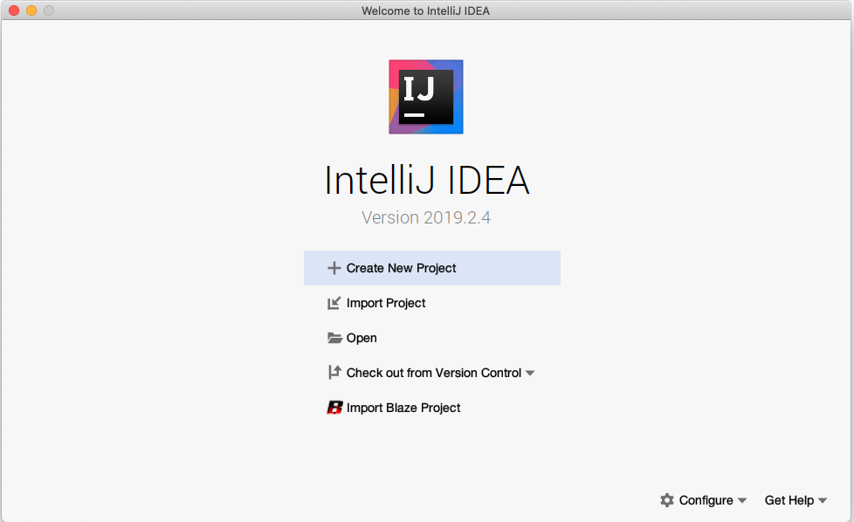
Open IntelliJ IDEA
Notes:
Click + Create New Project to start a new project.

Slide 5
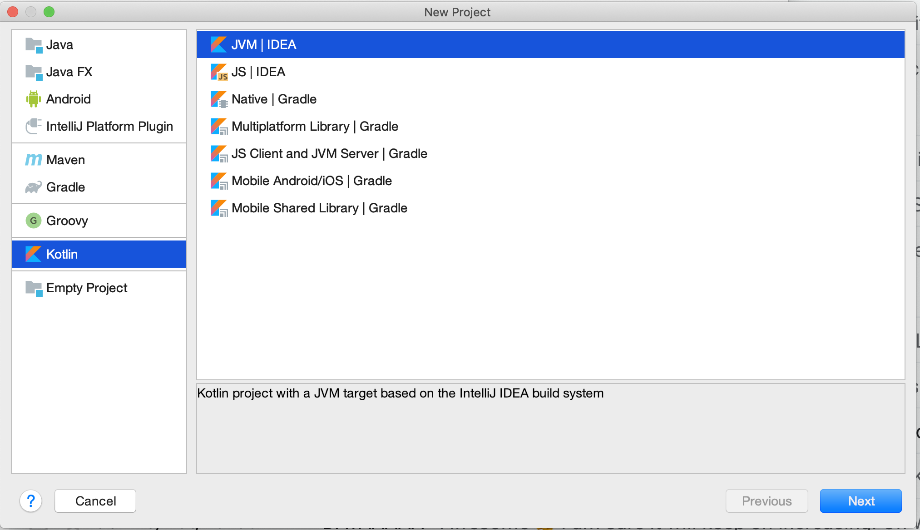
Create a new project
Notes:
Select Kotlin and JVM | IDEA, and click Next.

Slide 6
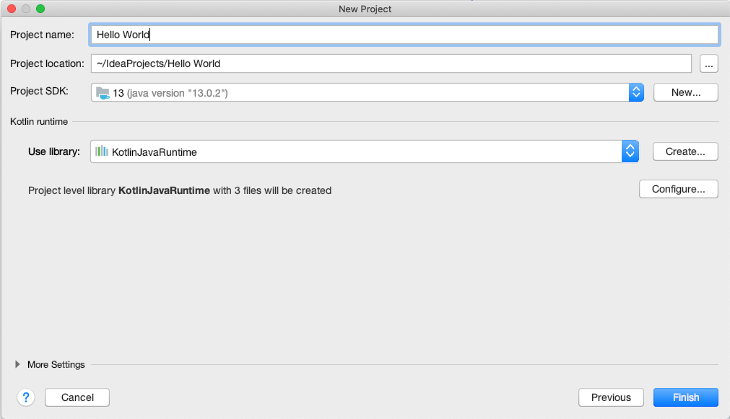
Name the project
Notes:
Name the project and click Next.

Slide 7
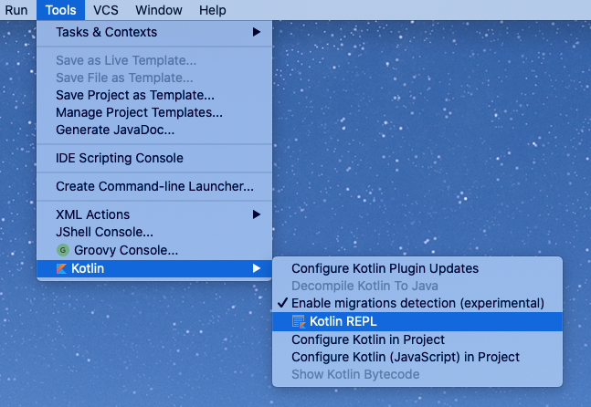
Open REPL (Read-Eval-Print-Loop)
It may take a few moments before the Kotlin menu appears under Tools.
Notes:
Select Tools > Kotlin > Kotlin REPL to open the REPL.

Slide 8
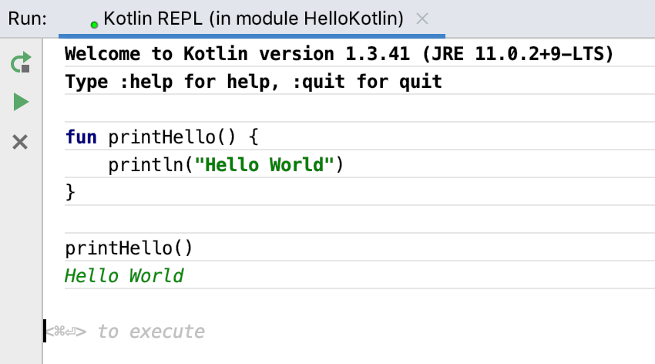
Create a printHello() function
Press Control+Enter (Command+Enter on a Mac) to execute.
Notes:
Enter the code below into the REPL:
fun printHello() {
println("Hello World")
}
Commands that you type into the REPL are interpreted as soon as you press Ctl+Enter (Cmd+Enter on a Mac). Let's take a quick look at the Kotlin code in this slide.
The fun keyword designates a function, followed by the name.
As with other programming languages, the parentheses are for function arguments, if any, and the curly braces frame the code for the function.
There is no return type because the function doesn't return anything.
Note that there are no semicolons at the ends of lines. If you're used to adding them, that's OK. You can either add them or leave them out.

Slide 9
Operators

Slide 10
Operators
- * / %
Mathematical operators
++ --
Increment and decrement operators
< <= > >=
Comparison operators
=
Assignment operator
== !=
Equality operators
Notes:
Let's start exploring Kotlin by having a look at its main elements, starting with numeric operators. As with other languages, Kotlin uses +, -, *, / and % for plus, minus, times, division and modulus (or remainder). There’s also the increment and decrement operators, comparison operators, assignment operator, and equality operators.

Slide 11
Math operators with integers
1 + 1 =>
2
53 - 3 =>
50
50 / 10 =>
5
9 % 3 =>
0
Notes:
Math operators are very straightforward, and behave just as you would expect based on other programming languages.

Slide 12
Math operators with doubles
1.0 / 2.0 =>
0.5
2.0 * 3.5 =>
7.0

Slide 13
Math operators
1+1
⇒ kotlin.Int = 2
1.0/2.0
⇒ kotlin.Double = 0.5
53-3
⇒ kotlin.Int = 50
2.0*3.5
⇒ kotlin.Double = 7.0
⇒ indicates output from your code.
Result includes the type (kotlin.Int).
50/10
⇒ kotlin.Int = 5
Notes:
Kotlin supports different number types, such as Int, Long, Double, and Float. Notice that they all start with an initial cap in the output. Although they may not be objects in the internal representation, they are objects in the sense that we can call member functions and properties on them, and Kotlin represents objects using initial caps. More on this later.

Slide 14
Numeric operator methods
Kotlin keeps numbers as primitives, but lets you call methods on numbers as if they were objects.
2.times(3)
⇒ kotlin.Int = 6
3.5.plus(4)
⇒ kotlin.Double = 7.5
2.4.div(2)
⇒ kotlin.Double = 1.2

Slide 15
Data types

Slide 16
Integer types
Type | Bits | Notes
Long | 64 | From -2⁶³ to 2⁶³-1
Int | 32 | From -2³¹ to 2³¹-1
Short | 16 | From -32768 to 32767
Byte | 8 | From -128 to 127
Notes:
Integer types in Kotlin are the same standard size as other languages.

Slide 17
Floating-point and other numeric types
Type | Bits | Notes
Double | 64 | 16 - 17 significant digits
Float | 32 | 6 - 7 significant digits
Char | 16 | 16-bit Unicode character
Boolean | 8 | True or false. Operations include: || - lazy disjunction, && - lazy conjunction, ! - negation
Notes:
Let's look at the non-integer numeric types: Double, Float, Char, and Boolean (including the boolean operators).

Slide 18
Operand types
Results of operations keep the types of the operands
6*50
⇒ kotlin.Int = 300
1/2
⇒ kotlin.Int = 0
6.0*50.0
⇒ kotlin.Double = 300.0
1.0*2.0
⇒ kotlin.Double = 0.5
6.0*50
⇒ kotlin.Double = 300.0
Notes:
Results of operations keep the types of the operands, so 1/2 = 0, but 1.0/2.0 = 0.5.

Slide 19
Type casting
Assign an Int to a Byte
val i: Int = 6
val b: Byte = i
println(b)
⇒ error: type mismatch: inferred type is Int but Byte was expected
Convert Int to Byte with casting
val i: Int = 6
println(i.toByte())
⇒ 6
Note that Kotlin does not implicitly convert between number types (e.g: short → int is not automatically converted, implicit conversion is a source of future errors)
Notes:
Transition: 1 click
Kotlin does not implicitly convert between number types, so you can't assign a Short value directly to a Long variable, or a Byte to an Int. Implicit number conversion is a common source of errors in programs, but you can avoid that by assigning values of different types with casting.
Here we create a variable and first show what happens if you try to reassign it with a type mismatch. We then use toByte() to cast it and print it without errors.

Slide 20
Underscores for long numbers
Use underscores to make long numeric constants more readable.
val oneMillion = 1_000_000
val idNumber = 999_99_9999L
val hexBytes = 0xFF_EC_DE_5E
val bytes = 0b11010010_01101001_10010100_10010010
Notes:
This is reason why we say Kotlin is expressive.

Slide 21
Strings
Strings are any sequence of characters enclosed by double quotes.
val s1 = "Hello world!"
String literals can contain escape characters
val s2 = "Hello world!\n"
Or any arbitrary text delimited by a triple quote (""")
val text = """
var bikes = 50
"""
Notes:
Strings are a sequence of characters enclosed by double quotes that may also contain spaces and numbers. Strings are immutable.
When a string appears literally in source code, it is known as a string literal or an anonymous string. Kotlin has two types of string literals: escaped strings that may have escaped characters in them, and raw strings that can contain newlines and arbitrary text. A raw string is delimited by a triple quote ("""), contains no escaping and can contain newlines and any other characters.

Slide 22
String concatenation
val numberOfDogs = 3
val numberOfCats = 2
"I have $numberOfDogs dogs" + " and $numberOfCats cats"
=> I have 3 dogs and 2 cats
Notes:
Strings in Kotlin work pretty much like strings in any other programming language using " for strings and ' for single characters, and you can concatenate strings with the + operator.
You can create string templates by combining them with values. In this example, $numberOfDogs and $numberOfCats are replaced with the value of those variables. This is called variable interpolation.

Slide 23
String templates
A template expression starts with a dollar sign ($) and can be a simple value:
val i = 10
println("i = $i")
=> i = 10
Or an expression inside curly braces:
val s = "abc"
println("$s.length is ${s.length}")
=> abc.length is 3
Notes:
Transition: 1 click
String literals can contain template expressions; pieces of code that are evaluated and whose results are concatenated into the string.

Slide 24
String template expressions
val numberOfShirts = 10
val numberOfPants = 5
"I have ${numberOfShirts + numberOfPants} items of clothing"
=> I have 15 items of clothing
Notes:
As in other languages, a value can be the result of an expression. Use curly braces {} to define the expression.

Slide 25
Variables

Slide 26
Variables
Powerful type inference
Let the compiler infer the type
You can explicitly declare the type if needed
Mutable and immutable variables
Immutability not enforced, but recommended
Kotlin is a statically-typed language. The type is resolved at compile time and never changes.
Notes:
Kotlin has powerful type inference, and usually you just let the compiler do the work by inferring it. However, you can explicitly declare the type of a variable. Kotlin does not enforce immutability, though it is recommended. In essence use val over var.

Slide 27
Specifying the variable type
Colon Notation
var width: Int = 12
var length: Double = 2.5
Important: Once a type has been assigned by you or the compiler, you can't change the type or you get an error.
Notes:
The type you store in a variable is inferred when the compiler can figure it out from context. If you want, you can also specify the type of a variable explicitly, using colon notation.
Some things to note about colon notation:
The data type comes after the variable name
Always put a space after :

Slide 28
Mutable and immutable variables
Mutable (Changeable)
var score = 10
Immutable (Unchangeable)
val name = "Jennifer"
Although not strictly enforced, using immutable variables is recommended in most cases.
Notes:
Kotlin supports two types of variables: changeable and unchangeable. With var, you can assign a value, then change the value later in the program. With val, you can assign a value once. If you try to change it to something else, you get an error.
Kotlin does not enforce immutability, though it is recommended. In essence use val over var.
Imagine you want to keep a pointer that point to an object, it is better to use val in that situation

Slide 29
var and val
var count = 1
count = 2
val size = 1
size = 2
=> Error: val cannot be reassigned
Notes:
Let’s look at an example. You can assign the count variable a value, then assign it a new value, because it is defined with var. Trying to assign a new value to size gives an error because it is defined with val.
Note that in Kotlin, by default, variables cannot be null. We'll talk about null safety a bit later in this lesson.

Slide 30
Conditionals

Slide 31
Control flow
Kotlin features several ways to implement conditional logic:
If/Else statements
When statements
For loops
While loops

Slide 32
if/else statements
val numberOfCups = 30
val numberOfPlates = 50
if (numberOfCups > numberOfPlates) {
println("Too many cups!")
} else {
println("Not enough cups!")
}
=> Not enough cups!
Notes:
The most common conditional is an if/else statement. If statements let you specify a block of code (the code within the curly braces following the if) that is executed only if a given condition is true. If the condition is false, then the code specified by an else statement is executed. Note that the else block is not required.

Slide 33
if statement with multiple cases
val guests = 30
if (guests == 0) {
println("No guests")
} else if (guests < 20) {
println("Small group of people")
} else {
println("Large group of people!")
}
⇒ Large group of people!
Notes:
As in other languages, you can have multiple cases by using else if. Note that you can use any comparison or equality operator in the if / else conditions, not just == or < as shown above. You can also use logical and ("&&"), and logical or ("||") operators. See the slide on Operators for more information.

Slide 34
Ranges
Data type containing a span of comparable values (e.g., integers from 1 to 100 inclusive)
Ranges are bounded
Objects within a range can be mutable or immutable
Notes:
A range (or "interval") defines the inclusive boundaries around a contiguous span of values of some comparable type, such as an intRange (for example, integers from 1 to 100 inclusive). The first number is the start point, the second number is the endpoint.
All ranges are bounded, and the left side of the range is always <= the right side of the range.
Although the implementation itself is immutable, there is no restriction that objects stored must also be immutable. If mutable objects are stored here, then the range effectively becomes mutable.

Slide 35
Ranges in if/else statements
val numberOfStudents = 50
if (numberOfStudents in 1..100) {
println(numberOfStudents)
}
=> 50
Note: There are no spaces around the "range to" operator (1..100)
Notes:
In Kotlin, the condition you test can use ranges, too. Ranges let you specify a subset of a larger group, so here, for example, we're only concerned with integers between 1 and 100. (i.e., a range of values of type Int, or IntRange). There are equivalent classes to IntRange for each of the other types, such as CharRange and LongRange.
Optional
You can also define a step size between the bounding elements of the range. For example, in 1..8, if we defined a step size of 2, our range would include the elements 1, 3, 5, 7. (see Ranges).
Example:
for (i in 1..8 step 2) print(i)
=>1357

Slide 36
when statement
when (results) {
0 -> println("No results")
in 1..39 -> println("Got results!")
else -> println("That's a lot of results!")
}
⇒ That's a lot of results!
As well as a when statement, you can also define a when expression that provides a return value.
Notes:
There's a nicer way to write a series of if/else statements in Kotlin, using the when statement. It's a bit like the "switch" statement in other languages. Conditions in a when statement can also use ranges.
Resource:
See When Expression

Slide 37
for loops
val pets = arrayOf("dog", "cat", "canary")
for (element in pets) {
print(element + " ")
}
⇒ dog cat canary
You don’t need to define an iterator variable and increment it for each pass.
Notes:
Kotlin supports for loops, while loops, do-while loops. Let’s look at examples of each one starting with for loops.
Here, we use a for loop to iterate through the array and print the elements.

Slide 38
for loops: elements and indexes
for ((index, element) in pets.withIndex()) {
println("Item at $index is $element\n")
}
⇒ Item at 0 is dog
Item at 1 is cat
Item at 2 is canary
Notes:
In Kotlin, you can loop through the elements and the indexes at the same time.

Slide 39
for loops: step sizes and ranges
for (i in 1..5) print(i)
⇒ 12345
for (i in 5 downTo 1) print(i)
⇒ 54321
for (i in 3..6 step 2) print(i)
⇒ 35
for (i in 'd'..'g') print (i)
⇒ defg
Notes:
You can specify ranges of numbers or characters, alphabetically. As in other languages, you don't have to step forward by 1. You can define the step size. You can also step backward using downTo.

Slide 40
while loops
var bicycles = 0
while (bicycles < 50) {
bicycles++
}
println("$bicycles bicycles in the bicycle rack\n")
⇒ 50 bicycles in the bicycle rack
do {
bicycles--
} while (bicycles > 50)
println("$bicycles bicycles in the bicycle rack\n")
⇒ 49 bicycles in the bicycle rack
Notes:
Transition: 1 click
Like other languages, Kotlin has while loops, do...while loops, and ++ and -- operators.

Slide 41
repeat loops
repeat(2) {
print("Hello!")
}
⇒ Hello!Hello!
Notes:
Kotlin also has repeat loops that let you repeat a block of code that follows inside its curly braces. The number in parentheses is the number of times it should be repeated. This print command is executed twice.

Slide 42
Lists and arrays

Slide 43
Lists
Lists are ordered collections of elements
List elements can be accessed programmatically through their indices
Elements can occur more than once in a list
An example of a list is a sentence: it's a group of words, their order is important, and they can repeat.
Notes:
A list is an ordered collection with access to its elements via indices—integer numbers that reflect their position. Elements can occur more than once in a list.

Slide 44
Immutable list using listOf()
Declare a list using listOf() and print it out.
val instruments = listOf("trumpet", "piano", "violin")
println(instruments)
⇒ [trumpet, piano, violin]
Notes:
Lists created with listOf() cannot be changed (immutable).

Slide 45
Mutable list using mutableListOf()
Lists can be changed using mutableListOf()
val myList = mutableListOf("trumpet", "piano", "violin")
myList.remove("violin")
⇒ kotlin.Boolean = true
With a list defined with val, you can't change which list the variable refers to, but you can still change the contents of the list.
Notes:
Next, we'll use mutableListOf to create a list that can be changed. In the example, the remove() method returns true when it successfully removes the item passed.
Note that in the result ("kotlin.Boolean"), Boolean starts with an initial cap because it's an object. Although you'll see it in REPL, for subsequent slides, we'll omit the type in the result for clarity.

Slide 46
Arrays
Arrays store multiple items
Array elements can be accessed programmatically through their indices
Array elements are mutable
Array size is fixed
Notes:
Arrays are used to organize data so that a related set of values can be easily sorted or searched.

Slide 47
Array using arrayOf()
An array of strings can be created using arrayOf()
val pets = arrayOf("dog", "cat", "canary")
println(java.util.Arrays.toString(pets))
⇒ [dog, cat, canary]
With an array defined with val, you can't change which array the variable refers to, but you can still change the contents of the array.
Notes:
Like other languages, Kotlin has arrays. Unlike lists in Kotlin, which have mutable and immutable versions, there is no mutable version of an Array. Once you create an array, the size is fixed. You can't add or remove elements, except by copying to a new array.
Declare an array of strings using arrayOf(). Use the java.util.Arrays.toString() array utility to print it out.
Note that you can also add "import java.util.Arrays" and then use "println(Arrays.toString(school)" to print it.
The rules about using val and var are the same with arrays as for lists.

Slide 48
Arrays with mixed or single types
An array can contain different types.
val mix = arrayOf("hats", 2)
An array can also contain just one type (integers in this case).
val numbers = intArrayOf(1, 2, 3)
Notes:
You can declare arrays with a mix of types, or just one type for all the elements. In the second example, although we define an array of only integers using intArrayOf(). There are corresponding builders, or instantiation functions, for arrays of other types.

Slide 49
Combining arrays
Use the + operator.
val numbers = intArrayOf(1,2,3)
val numbers2 = intArrayOf(4,5,6)
val combined = numbers2 + numbers
println(Arrays.toString(combined))
=> [4, 5, 6, 1, 2, 3]
Notes:
In this example, we combine the two arrays and then println the resulting array.
Be sure to add import java.util.Arrays as a header if you have not already done so.
Note that operator overloading is happening in the background and that + is calling
operator fun plus(other:IntArray) : IntArray
numbers2.plus(numbers) would generate the same result as numbers2 + numbers

Slide 50
Null safety

Slide 51
Null safety
In Kotlin, variables cannot be null by default
You can explicitly assign a variable to null using the safe call operator
Allow null-pointer exceptions using the !! operator
You can test for null using the elvis (?:) operator
Notes:
A hallmark of Kotlin, is its attempt to eliminate the danger of null references in code. Null references occur when code attempts to access a variable that doesn't refer to anything, potentially stopping code execution and causing a NullPointerException.

Slide 52
Variables cannot be null
In Kotlin, null variables are not allowed by default.
Declare an Int and assign null to it.
var numberOfBooks: Int = null
⇒ error: null can not be a value of a non-null type Int
Notes:
Let's talk about nullable versus non-nullable variables. Programming errors involving nulls have been the source of countless bugs. Kotlin seeks to reduce bugs by introducing non-nullable variables. Because variables cannot be null by default, there is less risk of code code execution failing due to NullPointerExceptions. The line of code above, for example, is not allowed by the compiler.

Slide 53
Safe call operator
The safe call operator (?), after the type indicates that a variable can be null.
Declare an Int? as nullable
var numberOfBooks: Int? = null
In general, do not set a variable to null as it may have unwanted consequences.
Notes:
That took care of the error. When you have complex data types, such as a list:
You can allow the elements of the list to be null.
You can allow for the list to be null, but if it's not null its elements cannot be null.
You can allow both the list or the elements to be null.

Slide 54
Testing for null
Check whether the numberOfBooks variable is not null. Then decrement that variable.
var numberOfBooks = 6
if (numberOfBooks != null) {
numberOfBooks = numberOfBooks.dec()
}
Now look at the Kotlin way of writing it, using the safe call operator.
var numberOfBooks = 6
numberOfBooks = numberOfBooks?.dec()
Notes:
Transition: 1 click
You can test for null with the ? operator, saving you the pain of writing many if/else statements.
Although the first example is written in Kotlin, it's more the way you might test for null in Java or other languages. It's still in Kotlin, but it's not the idiomatic Kotlin way to do it. The last line of code in the example simply says "call dec() on numberOfBooks if it's not null."

Slide 55
The !! operator
If you’re certain a variable won’t be null, use !! to force the variable into a non-null type. Then you can call methods/properties on it.
val len = s!!.length
throws NullPointerException if s is null
Warning: Because !! will throw an exception, it should only be used when it would be exceptional to hold a null value.
Notes:
If you really love NullPointerExceptions, Kotlin lets you keep them. The not-null assertion operator, !! (double-bang), converts any value to a non-null type and throws an exception if the value is null.
In programming slang, the exclamation mark is often called a "bang," so the not-null assertion operator is sometimes called the "double-bang" or "bang bang" operator.
Warning: Because !! will throw an exception, it should only be used when it would be exceptional to hold a null value.

Slide 56
Elvis operator
Chain null tests with the ?: operator.
numberOfBooks = numberOfBooks?.dec() ?: 0
The ?: operator is sometimes called the "Elvis operator," because it's like a smiley on its side with a pompadour hairstyle, like Elvis Presley styled his hair.
Notes:
The example is shorthand for:
"if numberOfBooks is not null, decrement and use it; otherwise use the value after the ?:, which is 0."
If numberOfBooks is null, evaluation is stopped, and the dec() method is not called. Combining the null tests with the elvis operator reduces them to a single line, and avoids having to use a longer if/else statement.
Resource:
Elvis Operator

Slide 57
Summary

Slide 58
Summary
In Lesson 1, you learned how to:
Create an IntelliJ IDEA project, opening REPL, and execute a function
Use operators and numeric operator methods
Use data types, type casting, strings, and string templates
Use variables and type inference, and mutable and immutable variables
Use conditionals, control flow, and looping structures
Use lists and arrays
Use Kotlin's null safety features

Slide 59

Pathway
Practice what you’ve learned by completing the pathway:
Lesson 1: Kotlin basics

